Slide 1
Azure Platform-as-a-Service

Slide 2
Agenda
Time | Session | Time (mins) | Activity
9:00 to 10:00 | Intro to Azure | 40 | Presentation and Demos
 |  | 20 | Hands-on Lab
10:00 to 10:20 | Morning Tea | 20
10:20 to 12:00 | Azure App Service | 30 | API - Presentation and Demos
 |  | 25 | Web - Presentation and Demos
 |  | 45 | Hands-on Labs
12:00 to 13:00 | Lunch | 60
13:00 to 14:15 | Azure AD and API Management | 30 | Presentation and Demos
 |  | 45 | Hands-on Labs
14:15 to 15:15 | Azure IaaS | 30 | Presentation and Demos
 |  | 30 | Hands-on Labs
15:15 to 15:30 | Evening Tea | 15
15:30 to 16:30 | Data Overview | 30 | Presentation and Demos
 |  | 30 | Hands-on Labs - DocumentDB
16:30 | Closing

Slide 3
Host your applications on Azure
The three ways to host your applications on the Microsoft Azure Platform
Infrastructure as a Service
IaaS
Platform as a Service
PaaS
Notes:
Making the point that Virtual Machines is IaaS while both CloudServices and Websites are PaaS.

Slide 4
Automation
Innovation
Reduced cycle time
Elasticity
Versioning environments
Continuous Deployment
Speed to market
Feedback loop
Agility
Continuous
Improvements
QoS
Availability
Insights
Growth
TCO
Notes:
Slide Objectives:
Reiterate the point that to make your service successful, you are partnering with Azure. You bring the code, and Azure brings resources.
This slide also sets state for the talk by explaining how IaaS components fit into the overall picture.
Speaker Notes:
[Continue with previous slide]
To make your service successful, you are partnering with Azure. You bring the code, and Azure brings resources. [Click] And you keep iterating and making improvements over time. [Click]
Once this partnership is going, a lot of good things follow. For instance, you get automated deployment, versioned environments, and eventually continuous deployment. [Click]
You’ll have shorted cycle time, faster feedback loops, and faster speed to market. [Click]
This also frees up your energy to gain additional business insights, to innovate, and to continuously improve your business.
And as your business is settled on cloud, you can leverage cloud to improve quality of service (QoS), to reduce total cost of ownership (TCO), and elasticity to allow Azure adapts to your business growth.

Slide 5
Agenda
Web App creation
Language Support
Deployment
Source Control Integration
Scale
Web Jobs
Site Slots
Traffic Manager
Backup
Hybrid Connections
Redis Cache

Slide 6
Azure App Service

Slide 7


Azure App Service Build and scale great cloud apps
Web Apps
Mobile Apps
Logic Apps
API Apps

Slide 8
App Service - one integrated offering
Web Apps
Mobile Apps
Web apps that scale with your business
Build Mobile apps for any device
LOGIC Apps
API Apps
Automate business process across SaaS and on-premises
Easily build and consume APIs in the cloud
Notes:
API and Logic in Preview

Slide 9
Develop apps with…
.NET | Node.js | PHP | Python | Java

Slide 10
Benefits of App Services
Automatic OS patching
Enterprise-grade security
High availability
Automated scale out/in
Built-in load balancing
Supports many languages and platforms
.NET, Node.js, Python, Ruby and many more
Easy continuous deployment
Continuous delivery from third-party source control providers
Built-in Git repo

Slide 11



Web Apps
Logic Apps
Mobile Apps
Administration App
Customer site
Order Completed
Customer App
http
SQL
API Apps

Slide 12
Web Apps

Slide 13
Full capability set available including:
.NET, Node.js, Java, PHP, and Python
WebJobs for long running tasks
Integrated VS publish, remote debug…
CI with GitHub, BitBucket, VSO
Auto-load balance, Autoscale, Geo DR
Virtual networking and hybrid connections
Site slots for staged deployments
Web Apps
Web apps run as-is
no changes required

Slide 14



Azure App Service Web Apps
Start simple
Code smart
Go live
Easily create and scale your new sites in seconds
Automatically scale your sites that scale with your business
Quickly improve performance and reduce latency with right resources
Built-in web jobs support
Leverage existing skills – Languages and databases you know
Start with open source apps and frameworks
Develop with VS and WebMatrix
Supports X-Plat development
Improve developer productivity through continuous automated deployment
Built-in monitoring of perf and usage data
Built-in diagnostics to assist with debugging
Built for DevOps
Office Blog ASP.NET site microsoft.com
Notes:
Speaker notes:
Start simple
Emphasize rapid deployment of Web Apps from choice of Asp.Net starter applications to thousands of pre-built certified, opensource, and community software applications, add-ons, and data analysis platforms pre-configured for Azure.
Explain how Web Apps use automatic load balancing to scale out.
With Web Apps its easy to scale out automatically with increasing instance count using autoscale features e.g. CPU Load, scheduled
Easily improve performance of Web Apps and reduce latency of by changing to right instance size with zero downtime
Supports cron jobs
Code smart
Leverage existing skills to start coding for Web Apps without expensive retraining:
Languages: .NET, Java, NodeJS, PHP, Python. Databases: SQL Server, MySql .
Start coding with any development tools on any platforms such as Linux, OSX and Windows.
Go live
Built for DevOps – Agility through continuous deployment.
Encourages iterative development and improves developer productivity through continuous automated deployment enabled by Web Apps’ integrated source control connectivity to Team Foundation Server(TFS) and Git.
Easily monitor key performance metrics in a verbose or minimal fashion. Easily access monitoring data from a storage account externally for further analysis.
Easily enable diagnostics logging and add instrumentation. Easy access to information logged.

Slide 15
App Service Web App
Web Site
Monaco
MSDeploy
Build/Upload Your Own
Kudu
Web Jobs
Gallery
Public Site Extensions
Private Site Extensions
Azure App Service Web App

Slide 16
Demo: Creating a Wordpress Blog

Slide 17
App Service Web App Architecture
Deployment
Server(s)
File Server
Publish Endpoint
Blob Storage
Application Database
Frontend (IIS ARR)
Microsoft Azure
Load Balancer
Metering
Runtime Database
API Endpoint

Slide 18
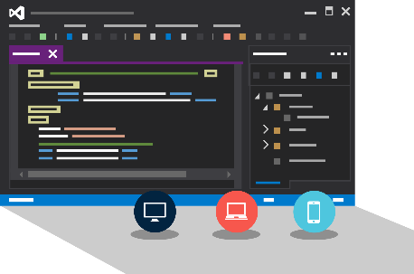
Visual Studio + App Service Web Apps
Create Azure Resources during File / New
Create Web App during deploy
Manage with Server Explorer

Slide 19
WebJobs

Slide 20






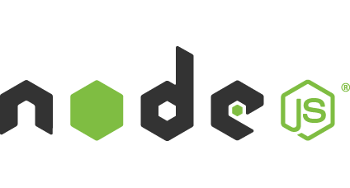

Light-weight CPU Intensive Tasks
run.cmd, run.bat
run.exe
run.ps1
run.sh
run.php
run.py
run.js
Job Type:
On-Demand, Scheduled, Continuous
Scale:
Singleton, Multi-instance
WebJobs SDK Feature:
BlobTrigger, TableTrigger, QueueTrigger, ServicebusTrigger
Deployment:
Portal, Visual Studio, CLI, Git

Slide 21

WebJobs
Web App

Slide 22
WebJobs
Web App

Slide 23
Demo: WebJobs

Slide 24
API Apps

Slide 25
Easily use cloud or custom APIs:
Dozens of built-in APIs for popular SaaS
An ecosystem of APIs for any need
Create and publish custom, reusable APIs
Visual Studio tooling with one click publish and remote debugging
Automatic client SDK generation for many languages
Api Apps
Create, consume and
host APIs more easily

Slide 26
Benefits of API Apps
Bring your API as-is
.NET Web API
Node.js + Express
Java
PHP
Many other technologies
Connect easily to SaaS platforms

Slide 27
API Apps addresses key pains around building and consuming APIs
Build your API
Consume APIs
Web Apps++: Bring you API as is in your language of choice
API discovery
SDK generation
SSO, handled by server
Authentication, built-in to mobile and web SDKs
Expose enterprise APIs
Microservice style
Metadata contract
SSO
Simple access control
Gallery – public & organization

Slide 28
Demo: Creating an API App

Slide 29
Consuming API Apps
API Apps expose HTTP services
Metadata is exposed using Swagger 2.0 metadata
JSON file
Widely supported
Client applications

Slide 30
Enterprise connectivity
Dynamics
SQL
SAP
Oracle

Slide 31




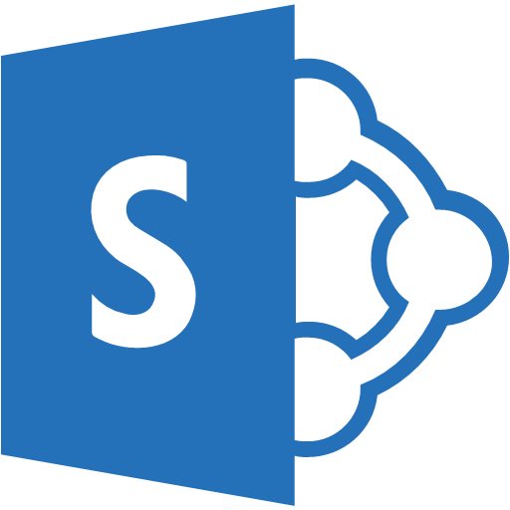

Simplifying Integration
Managed Middle Tier
API App[s]
On Premise Applications
Databases in Azure VMs
SharePoint Online
Cloud-Hosted Web Apps
SSO, Auth, Scale, etc.

Slide 32
Logic Apps

Slide 33
New Logic Apps for easy automation
No code designer for rapid creation
Dozens of pre-built templates to get started
Out of box support for popular SaaS and on-premises apps
Use with custom API apps of your own
Biztalk APIs for expert integration scenarios
LOGIC Apps
Automate SaaS and
on-premises systems

Slide 34
SaaS integration

Slide 35
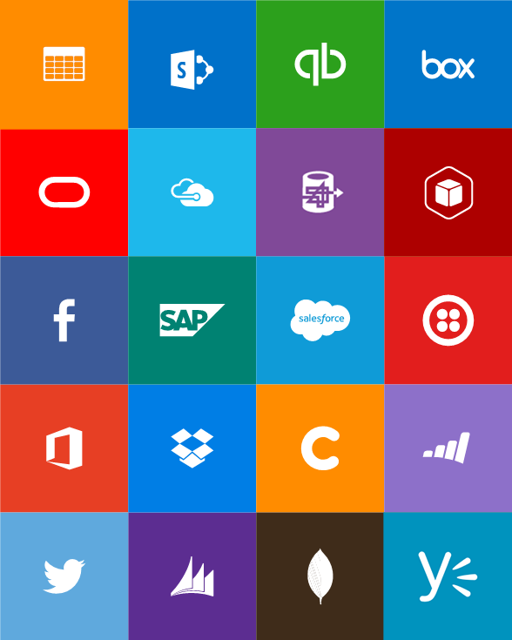
Built-in API Connectors
Connectors
Box
Chatter
Delay
Dropbox
Azure HD Insight
Marketo
Azure Media Services
OneDrive
SharePoint
SQL Server
Office 365
Oracle
QuickBooks
SalesForce
Sugar CRM
SAP
Azure Service Bus
Azure Storage
Timer / Recurrence
Twilio
Twitter
IBM DB2
Informix
Websphere MQ
Azure Web Jobs
Yammer
Dynamics CRM
Dynamics AX
Hybrid Connectivity
Protocols
BizTalk Services
HTTP, HTTPS
File
Flat File
FTP, SFTP
POP3/IMAP
SMTP
SOAP + WCF
Batching / Debatching
Validate
Extract (XPath)
Transform (+Mapper)
Convert (XML-JSON)
Convert (XML-FF)
X12
EDIFACT
AS2
TPMOM
Rules Engine

Slide 36
Target audience is anyone who can use Azure
… but not necessarily business users or consumers

Slide 37
Mobile Apps

Slide 38
New capabilities for Mobile apps:
Webjobs for long running tasks
CI with GitHub, BitBucket, VSO
Auto-load balance, Autoscale, Geo DR
Virtual networking and hybrid connections
Site slots for staged deployments
Mobile Apps
Mobile services plus
a whole lot more

Slide 39







Azure Mobile Services
Storage
Authentication
Logic
Push
Scheduler
Notes:
Speaking Notes
Summarize earlier slide
Azure Mobile Services is a Backend-as-a-Service
Instead of you having to design, build, test, deploy, manage, and upgrade your whole backend, we do it for you
Features of Mobile Services
Storage – SQL DB
Authentication – built in support for social providers w/ ability to custom auth
Backend logic – data validation, logical flows, etc
Push Notifications – across all major mobile platforms
Scheduler – backend job processing

Slide 40
Structured Storage
Powered by SQL Database
Supports rich querying capabilities
Dynamic Schematization
Data management in:
Azure Portal
SQL Portal (Silverlight)
SQL Management Studio
REST API
Azure CLI Tools
SQL CLI
Microsoft Azure
Notes:
Speaking points
Mobile Service easily connects to SQL Database
SQL offers rich querying and indexing capabilities
Dynamic Schematization means you don’t have to be a DBA and manage schema
Data can be managed in:
Azure Portal (read and delete data)
SQL Portal (Silverlight)
SQL Management Studio (windows)
REST API (used by SDKs)
Azure CLI tools
SQL CLI (Node module)

Slide 41
Server Side Table Scripts
Node.js scripts
.NET Web API
backend in
Visual Studio
Passes through to SQL by default
MongoDB, Table Storage, SQL out of the box
Intercept CRUD requests to tables
Fully customizable
Notes:
Speaking points
Node backend generates Node scripts for each table action
Scripts intercept CRUD requests
Pass to SQL by default
Custom logic added here
Edit in portal (NODE)
.NET Backend creates Visual Studio project

Slide 42
Custom API
Non-table based endpoints
Accessible from
GET
POST
PUT
PATCH
DELETE
For node.js logic in scripts like table endpoints
For .NET delivered through a WebAPI
Expose any functionality you want
Microsoft Azure
Notes:
Speaking points
All scripts so far tied to a table action
Custom APIs are non-table based endpoints
Script functionality for normal HTTP methods

Slide 43
Continous Delivery with App Service

Slide 44
Continuous integration

Slide 45

Continuous Deployment for Web Apps
Web App Production Slot
Agility through Continuous Deployment
Auto-Swap
Hooks
Git pull
Commits
Changes
Web App Staging Slot
Source Control / Code Repo
Developer

Slide 46

Source Control for Web/API/Mobile Apps
Git
Visual Studio
Online
CodePlex
GitHub
BitBucket
DropBox
FTP
Choose your own adventure!
Notes:
Slide Objectives:
Objective #1
Transition:
Transition statement(s) to setup the slide
Speaking Points:
Speaking Point #1
Speaking Point #2
Notes:
Any notes go here

Slide 47
AutoScale

Slide 48
AutoScale
Web App

Slide 49
AutoScale
Web App

Slide 50
AutoScale
Web App

Slide 51
App Service Environment

Slide 52
App Service Environment (ASE)
New Premium Tier Feature
Dedicated compute resources and network resources
Increased Scaling Options
Directly created in a Virtual Network
Support all Web App features and capabilities
Support Web, Mobile and API Apps
Global Scale

Slide 53
Conceptual Model
App Service Plan
App Service Plan
App Service App
App Service App
App Service App
App Service App
App Service App
App Service App
SKU: Premium (# of sites, storage, slots…)
Compute Resource: P4 ( 8 cores, 14 GB memory)
Scale: 8
SKU: # of sites, storage, slots…
Compute Resource: cores, memory
Scale: number of instances
Note: For App Service Environment the SKU will always be Premium
Notes:
Speaker notes:
Explain how ASE differ from multi-tenant App Service using App Service Plan.

Slide 54
Application Insights

Slide 55
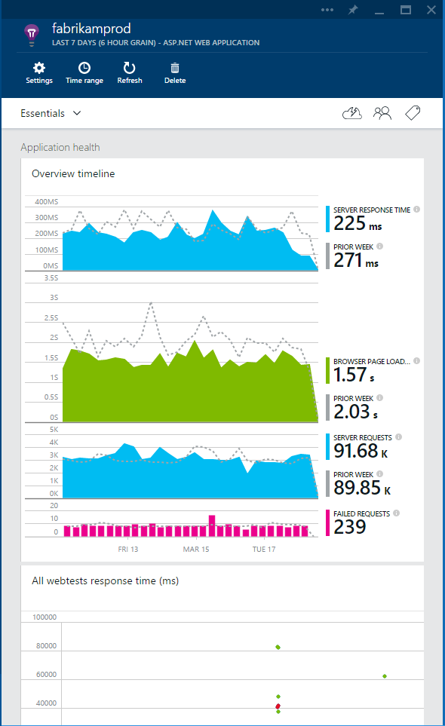
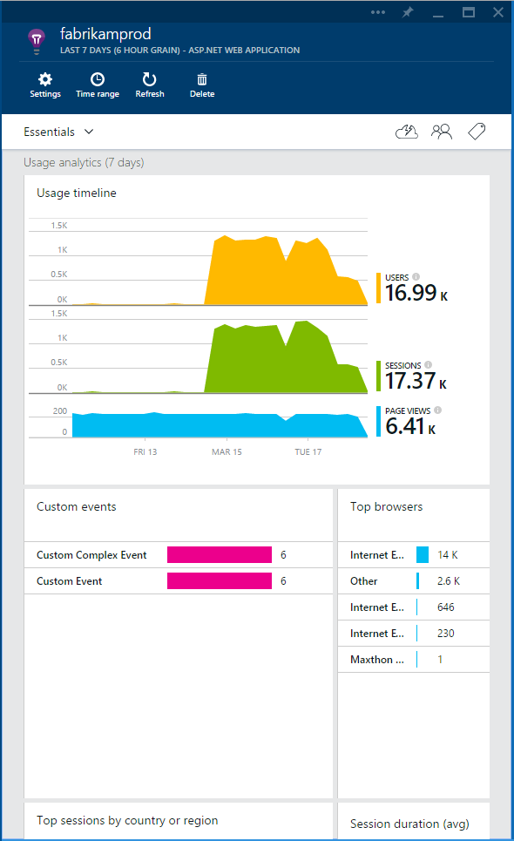

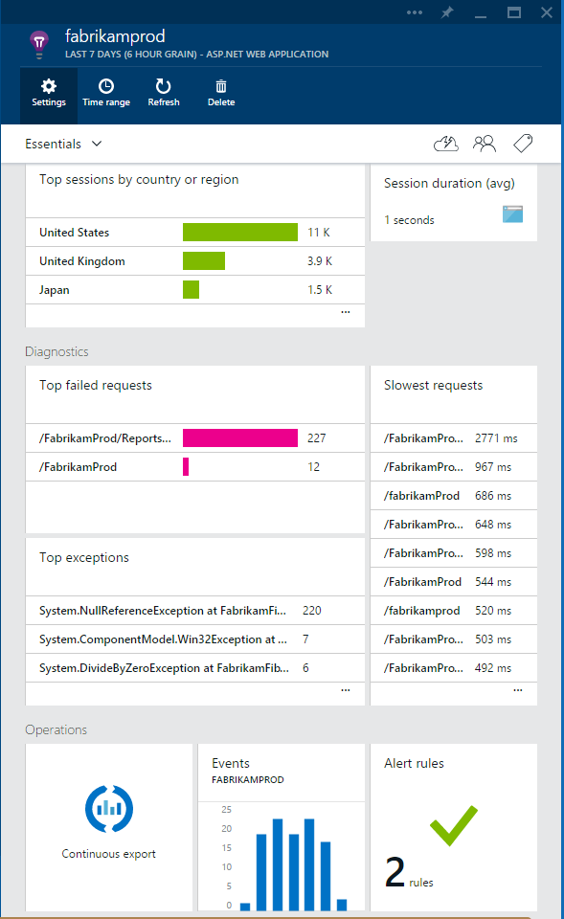


What is Application Insights?
3
1
Get a 360° view of the application including availability, performance and usage patterns
Telemetry is collected at each tier: mobile applications, server applications and browser
2
Telemetry arrives in the Application Insights service in the cloud where it is processed & stored
Notes:
Think of it as a three way end to end process
Whether youre making a mobile app, web app, server application
Some instances its as easy as adding via right click in VS

Slide 56
Demo: 360° Overview
We will explore:
Application Insights in Azure Portal
Out of the Box Telemetry for 360° view

Slide 57
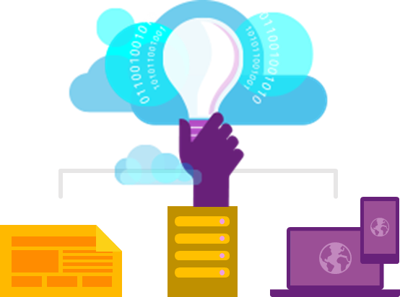
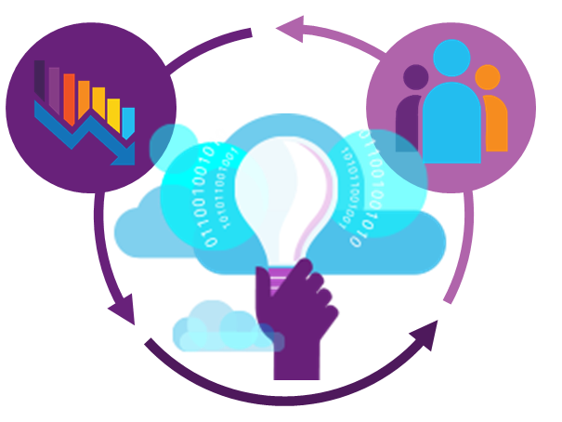
Key capabilities
360° view of your app with availability, performance and user behavior
Explore and analyze across dimensions to make informed prioritization decisions
360° View
Fully integrated with development tools across multiple platforms
Deep Insights
Built-in Analytics
EASY
POWERFUL
INVALUABLE

Slide 58









Supported Platforms & Languages
Any Platform - Any App
On-Prem, Azure, AWS, Google Cloud, App Stores…
Open Source SDKs https://github.com/Microsoft/ApplicationInsights-Home
Logging Frameworks Log4Net, nLog, System.Diagnostics, Log4J, Logback

Slide 59
Try App Service: Web Apps today
https://tryappservice.azure.com
Ask Questions:
Twitter:
Email
Public forum:

Slide 60
Q&A

Slide 61


Get started
Visit azure.microsoft.com

